Slide 1

Lunch-N-Learn
Docker Fundamentals
Future Systems Consulting & Services, Inc.
www.futuresystemsinc.com

Slide 2
What is Docker?
Single platform for building, running, and shipping applications
Works on multiple machines and environments
Package application with everything it needs
Application run in an isolated environment
Future Systems Consulting & Services, Inc.
www.futuresystemsinc.com
Notes:
IWOMM – It works on my machine
Software on target machine may be different
Different configuration seetings

Slide 3
Benefits of Docker
IWOMM - It works on my machine!
New developers no longer have to spend time setting up environments
Easily add and remove docker packages
Containers are scalable
Fast Deployment
Security
Cost Savings
Future Systems Consulting & Services, Inc.
www.futuresystemsinc.com
Notes:
Its really the benefits of Containers… docker is the tool for implementing these
IWOMM – It works on my machine
Software on target machine may be different
Different configuration seetings
Scalable – place many containers in a single host
Security –
less access required needed to work with code running in containers
Fewer software dependencies
Cost Savings
Can run on Linux

Slide 4
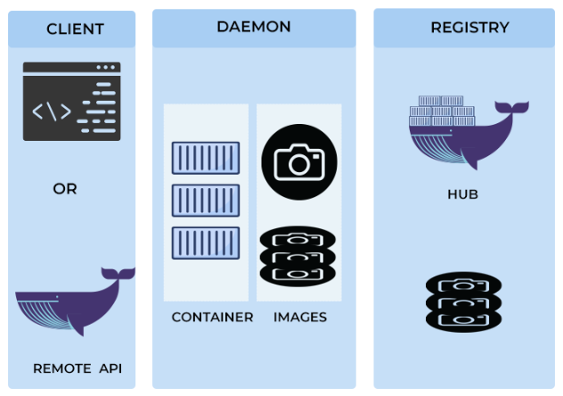
Docker, a closer look!
Future Systems Consulting & Services, Inc.
www.futuresystemsinc.com
Notes:
Uses client/server architecture
Client and Daemon on same host or daemon on remote host
Client & Daemon communicate using Rest API over Network interface
Client is how we interact with client
Daemon – is brains and handles commands like Docker Run
Communicates with underlying OS
Registries store docker images
Images are read-only template for creating container
Set of instructions
Container – living instance of docker image

Slide 5
Install Docker
Mac, Windows, or Linux
A native application for your specific OS that delivers all the Docker tools to your computer.
Verify System requirements
Free
https://docs.docker.com/get-docker/
Future Systems Consulting & Services, Inc.
www.futuresystemsinc.com
Notes:
"Docker Desktop Installer.exe" install
Start-Process 'Docker Desktop Installer.exe' -Wait install (PowerShell)
start /w "" "Docker Desktop Installer.exe" install (Command Prompt)

Slide 6
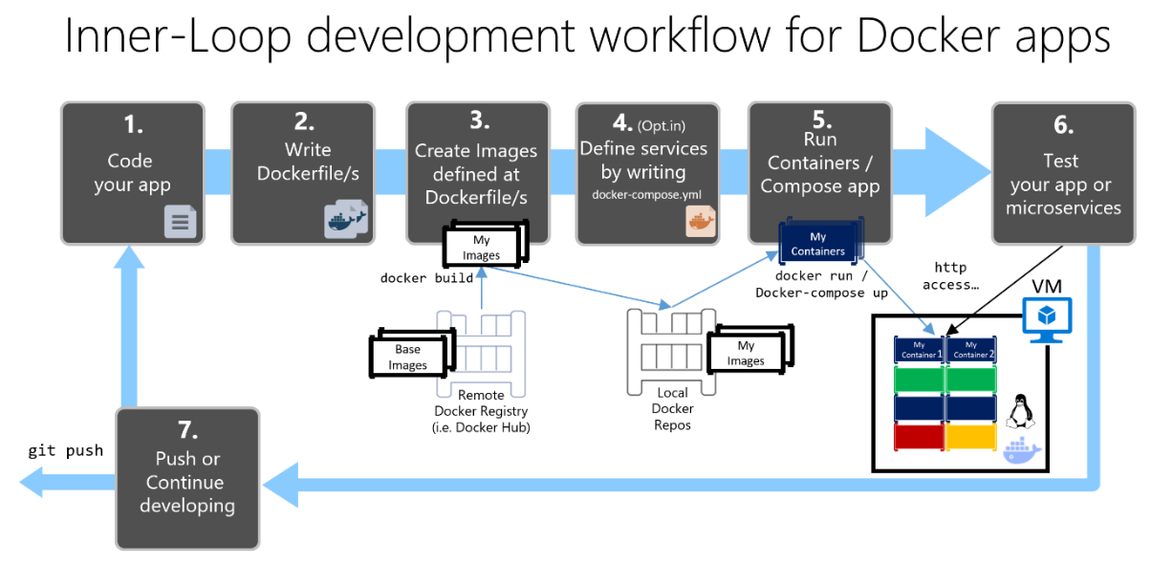
Development Workflow
https://learn.microsoft.com/en-us/dotnet/architecture/microservices/docker-application-development-process/docker-app-development-workflow
Future Systems Consulting & Services, Inc.
www.futuresystemsinc.com
Notes:
Dockerize an application
Add a docker file to it (Dockerfile)
Package into image
Application Image to a Registry
Local
Cloud
Load and run container image
Services (Optional) - Add a docker-compose.yml
Docker-compose – create the container

Slide 7
DEMO
Future Systems Consulting & Services, Inc.
www.futuresystemsinc.com

Slide 8
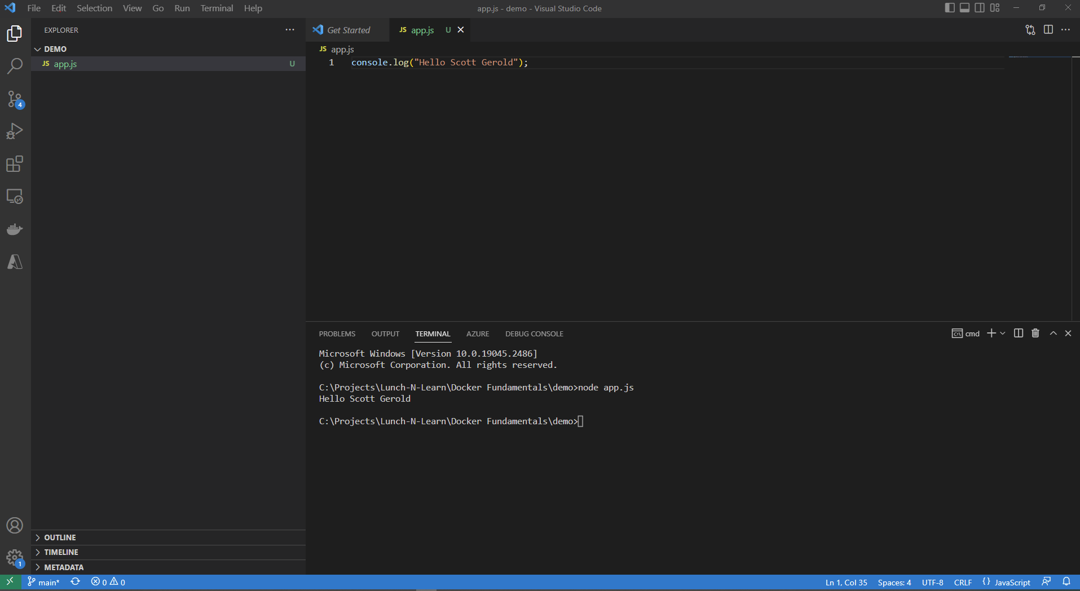
DEMO
Future Systems Consulting & Services, Inc.
www.futuresystemsinc.com
Notes:
Create folder
Open VS Code in that folder
Create app.js
Add line of code - console.log("Hello Scott Gerold");
Start terminal session and run “node app.js”

Slide 9
DEMO
Future Systems Consulting & Services, Inc.
www.futuresystemsinc.com
Notes:
Create Dockerfile
“FROM node:alpine”
node image ncluded in DockerHub
Alpine very small linux version
“COPY . /app”
Creates app directory
Copies the files
“WORKDIR /app”
“CMD node app.js”

Slide 10
DEMO
docker build -t hello-scott-gerold .
Docker image ls
Docker Run hello-scott-gerold
Future Systems Consulting & Services, Inc.
www.futuresystemsinc.com
Notes:
docker build -t hello-scott-gerold .
Docker image ls
Notice of ID
Notice of side
Show in docker desktop

